Slide 1

Incremental Data Loading into Delta Lake
Manage big data efficiently by loading only new or changed data into the system, hence saving time and resources.
19-Nov-23(v2)
Delta Lake

Slide 2
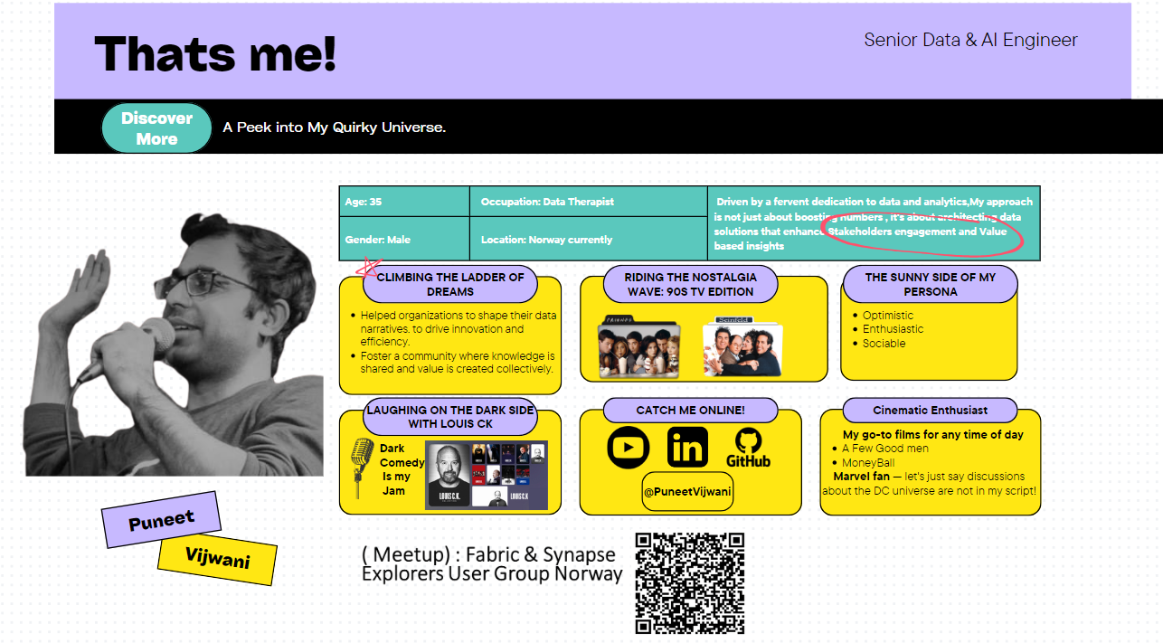

Slide 3

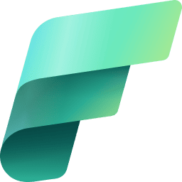


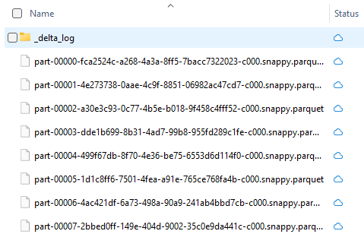
Delta Lake
SYNAPSE
FABRIC
DATABRICKS
Delta Lake provides robust transactional capabilities over big data, including ACID compliance for large-scale, distributed data processing. Data in Parquet files with a metadata file alongside them
DELTA LAKE
ADLS/ONE LAKE
Synapse
Spark Pools
Dataflows
Databricks
Databricks runtime
Fabric
Spark pool
Dataflow Gen 2
Pipelines
T-SQL
Shortcuts

Slide 4
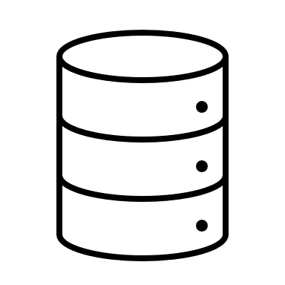
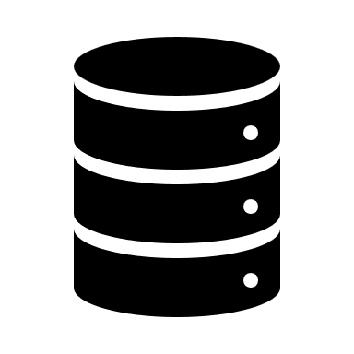
Why Incremental Loads ?
New or updated data into a system, rather than reloading the entire dataset.
Improve efficiency and save both time and computational resources.
Typically performed at regular intervals
Useful when dealing with large datasets or data lakes where full data loads can be time-consuming and resource-intensive.
Benefits
Reduce the Volumes of data needed to be loaded
Less computational power and storage are required
Keep the data up to date
Updated data can be made available to users more quickly.

Slide 5
On-boading Data Faster
Use case :- The current Sales analytics pipeline that loads data from the source DB to the Lakehouse runs as a full batch process taking over 3 hours. This leads to significant lag between transactions happening and analysis reports being updated. Business users have to wait for over hours each day to get the latest view of the data.
Pain :- Full load Batches run for hours and times out.
Solution :- Implement incremental data loading from Source into Lakehouse by Incremental load to only extract, transform and load the new, updated or deleted transactions since the last pipeline run. Modify existing logic to handle change detection alongside full loads. Introduce metadata driven approach and scheduling through to automate and monitor batch runs.
Outcome :- Reduce customer analytics batch runtime from 3 hours to 15-20 min hours through incremental loads & Enable 2 additional batch runs per day for a total of 4, Provide business users refreshed insights achieving near real-time analytics, Modular pipeline design for ease of maintenance and adding new data sources

Slide 6

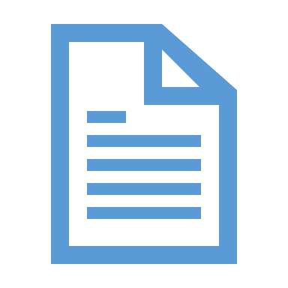
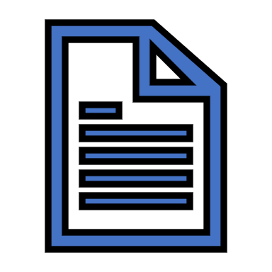
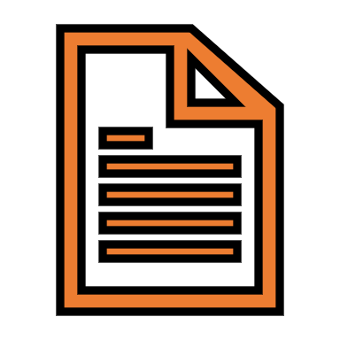
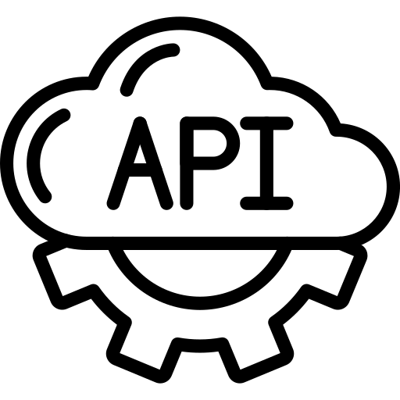

Patterns
Bronze
(Append Mode)
Source Raw
Silver Zone
DataFrame / Staged Zone
Clean & Merge
Full Load
Full Load
Silver Zone
DataFrame / Inc Zone
Incremental Load
Clean & Merge
Incremental Load

Slide 7
Patterns
Bronze
(Append Mode)
Source Raw
Silver Zone
DataFrame / Inc Zone
Incremental Load
Gold Zone
Incremental Load
Clean & Merge
DataFrame / Inc Zone
Incremental Load
Clean & Merge

Slide 8
Approaches
Comparison
Compare Source to Target Or Earlier Version/ Logs
Strengths: Ideally suited for small datasets.
Weaknesses: As the volume of data increases, so does the need for resources, making it potentially costly.
Watermark
Filtering source records with a Watermark Value
Strengths: Most commonly used
Weaknesses : Requires upkeep of a Watermark Table. / Dependent on the source's schema and columns.
Change feed
Capture Changes in a temporary location
Strengths: Allows direct analysis and reading of changes.
Weaknesses : Maintains the actual change feed data and history, which can expand if not properly managed.
Checkpoints
Adding checkpoints logs
Strengths: Spark native support / Focus on Business logic / No dependency on the schema of the source or processed state.
Weaknesses : May necessitate housekeeping/ best practices

Slide 9










Demo In Fabric
Expose
Comparision Incremental Load
CheckPoint Incremental Load
Azure’s Open DataSet
Bronze
Silver
Gold
(Append)
(Merge)
SQL End Point
Watermark’s Incremental Load
Transform
Sql Based Sources
Notebook’s

Slide 10

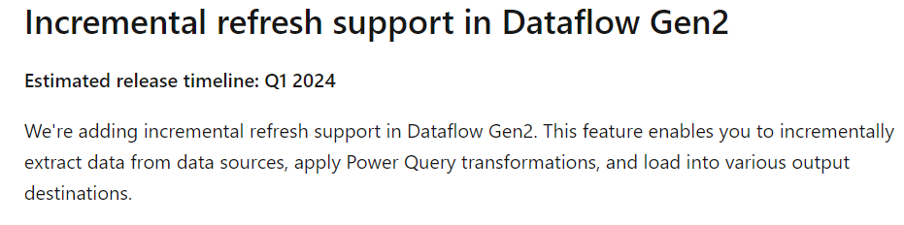
Other methods (Databricks Or Fabric )
* DLT
AutoLoader
CheckPoint Incremental Load
Landing
Bronze
Silver
Gold
Transform
On-Prem SQL Basesd Sources
Databricks

Slide 11
Things to consider !
Data Skew
Latency
Merge Strategy
Resource Utilization & Tuning
Parallel processing
Etc…..

Slide 12
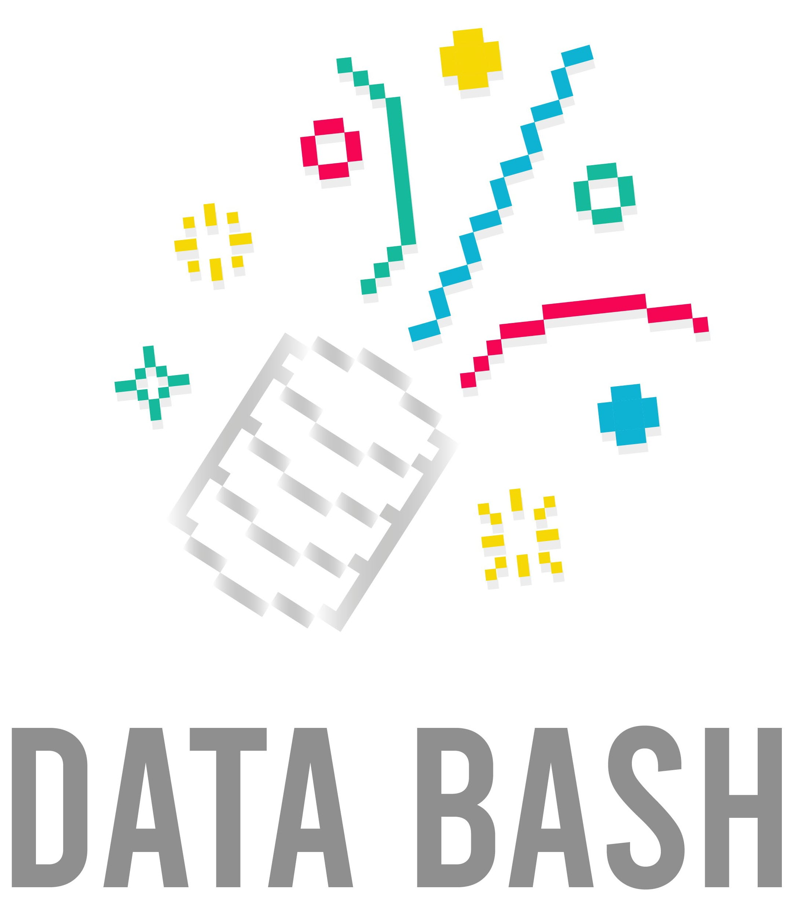



Our sponsors
Please consider to vist their websites, as we are able to finance the costs thanks to them.
DATA BASH is a non profit event with an non profit organization behind it, and without our sponsors,
we would not be able to finance the event.

Slide 13




Thank You!
( Meetup) : Fabric & Synapse Explorers User Group Norway
@puneetvijwani
@puneetvijwani

